Slide 1

Cleaning up! Proposal
Yeongrin Jeon 305179

Slide 2
Story & Objective
Story: Con and White clean up a warehouse in a lab that has been left unattended for 10 years!!!
Objective: Move the grid puzzle ground and remove all trash and monsters within a limited number of actions!
Before all the action and movement limits are exhausted, you will die.

Slide 3
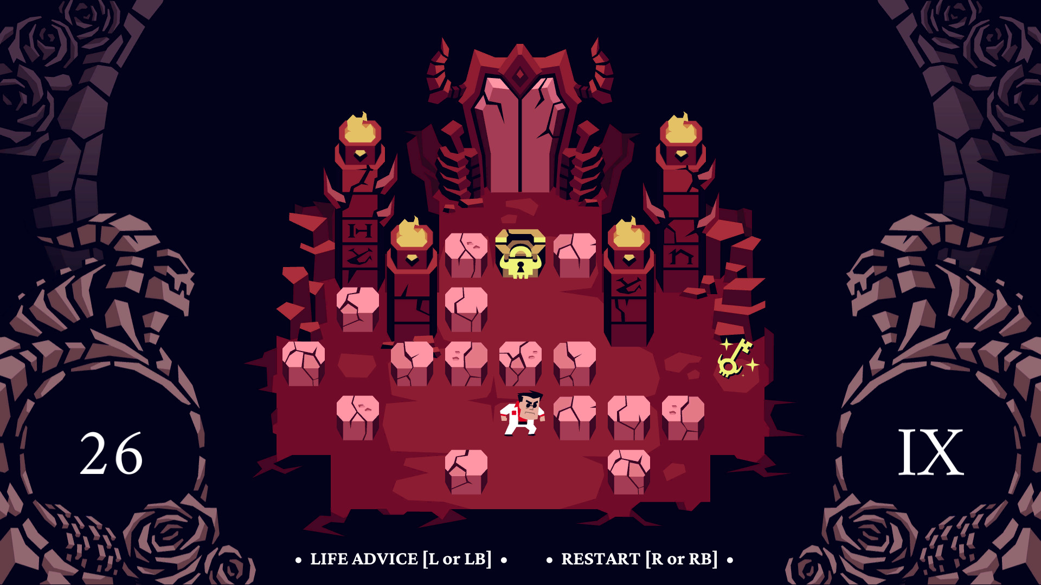
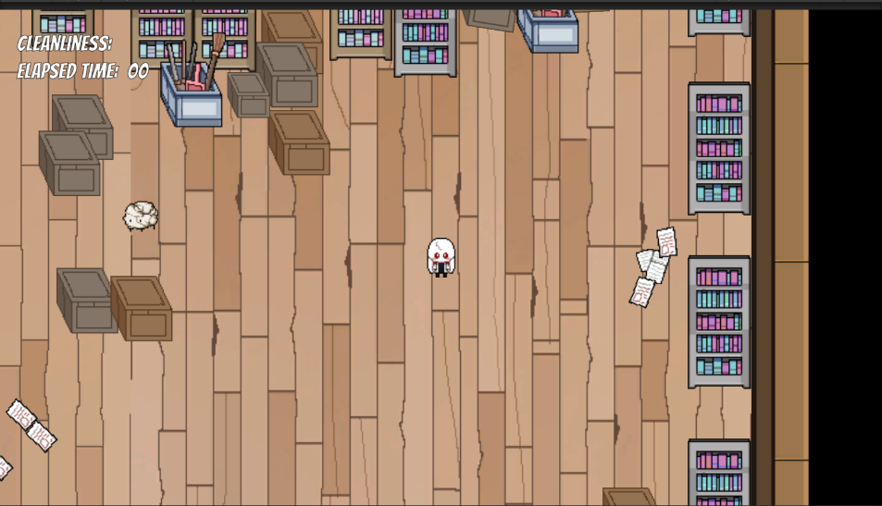
Motif
Mechanic -> “Helltaker”
Concept and Story -> Cleaning up! Which I made before…

Slide 4
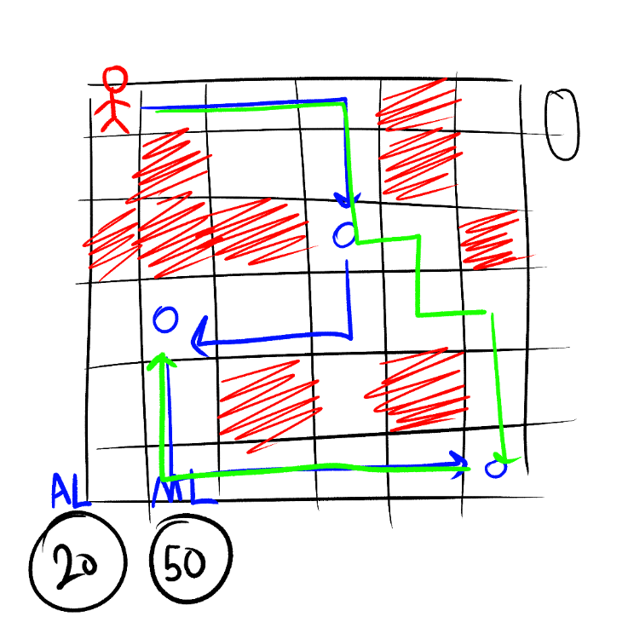



Concept
Red(Player): have movement limit and action limit.
Blue(Monster): Require action limit.
Green(Moving): Can move direction except diagonal. Requite movement limit. Find short cut.

Slide 5
Mechanics
There is no health…But!
Movement limit: When you move one space at a time, one will be exhausted. If you use up all these limit, you die on the field!
Action limit: When you attack one enemy at a time, one will be exhausted. If you use up all these times, you are killed by enemies!

Slide 6
Controls
Direction key
> Can move left, right, up and down
Z key
> Attack the enemies.
Press the Z key while holding down the arrow key!<

